Slide 1
Credit Card Fraud Detection
Ahmed Mohamed Ismail
Moaz Mohamed El Sherbini
Mostafa Ashraf Ahmed
Nader Youhanna Adib

Slide 2
What is Credit Card Fraud
Identity Theft
Online Fraud
Lost or Stolen Card Fraud
Card-Not-Present Fraud
Notes:
Identity theft occurs when a thief obtains someone's personal information, such as their name, address, Social Security number, or credit card number, and uses it to open new accounts or make unauthorized purchases.
Online fraud occurs when a thief uses stolen credit card information to make purchases online.
Lost or stolen card fraud occurs when a thief steals a physical credit card and uses it to make purchases.
Card-not-present fraud occurs when a thief uses stolen credit card information to make purchases over the phone or online, without having the physical card in their possession. Card-not-present fraud occurs when a thief uses stolen credit card information to make purchases over the phone or online, without having the physical card in their possession.

Slide 3
Fraud Statistics
In 2020, credit card fraud losses in the United States totaled $11.2 billion, up from $10 billion in 2019.
In 2020, the global cost of payment card fraud was estimated to be $27.85 billion.
Credit card fraud was the most common type of identity theft reported by consumers, accounting for 31% of all reported cases.
COVID-19 pandemic lead to increase in card-not-present frauds.

Slide 4
Technical Part

Slide 5
Data Preprocessing
Removed missing data
Removed illogical data (negative values for distance)
Handled outliers using percentiles
Normalized data
Feature extraction
Split the data (training, validation and testing)

Slide 6
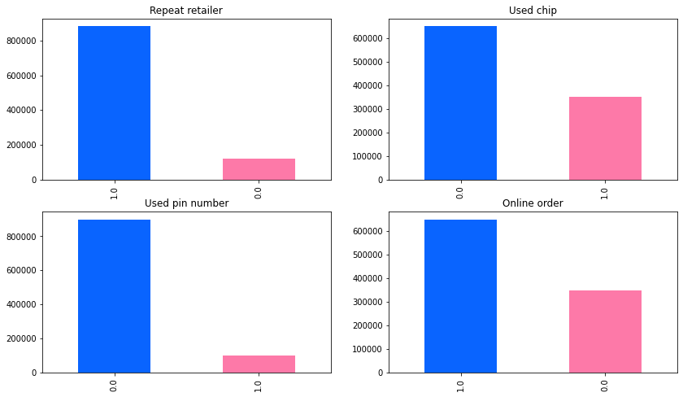
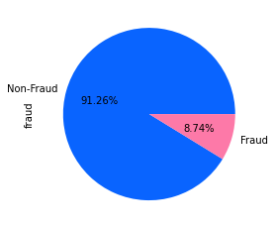

Slide 7
Data Insights
We cannot confidently predict if a transaction is fraudulent, we can, however, predict with high confidence that it is not fraudulent given some conditions (According to association rules).

Slide 8
Algorithms implemented
Logistic Regression
Minimum Distance Classifier
K Nearest Neighbours (with and without Spark)
Naïve Bayes
K means using Spark
Association Rules

Slide 9
Logistic Regression
Logistic Regression with cross-validation, max iterations = 1000
Accuracy = 96.36%
The feature with the highest weight was used_pin.
The feature with lowest weight was distance_from_last_transaction
Notes:
We suspect that if time was included, distance_from_last_transaction would have a much higher weight

Slide 10
Minimum Distance Classifier
Used Euclidean Distance
Accuracy = 91.30%

Slide 11

Naïve Bayes
Using Gaussian conditional probabilities
$P\left(X \right|C_{i})=\frac{e^{−\frac{1}{2}{\left(\underline{X}−\underline{μ}\right)}^{T}Σ^{−1}(\underline{X}−\underline{μ}) } }{{\left(2∙π\right)}^{\frac{N}{2}} \det^{\frac{1}{2}}(Σ) }$
Accuracy = 87.35%

Slide 12
K Nearest Neighbours
K = 3 Accuracy : 98.3%
K = 5 Accuracy : 98.16%
K = 7 Accuracy : 99.16%

Slide 13
K Means
No accuracy since it is not a classification algorithm
WSS = 3311305539.2

Slide 14
References
https://www.paymentsdive.com/news/card-industry-fraud-fighting-efforts-pay-off-nilson-report-credit-debit/639675/#:~:text=Dive%20Brief%3A,last%20year%20of%20%24408.50%20billion.
https://www.ftc.gov/news-events/topics/consumer-finance/credit-cards

Slide 15


Slide 16


